Slide 1

Administrating SSRS without boring web based clicks!
Cláudio Silva, SQL Server DBA & PowerShell MVP

Slide 2
Just like Jimi Hendrix …
We love to get feedback
Please complete the session feedback forms

Slide 3
SQLBits - It's all about the community...
Please visit Community Corner, we are trying this year to get more people to learn about the SQL Community, equally if you would be happy to visit the community corner we’d really appreciate it.

Slide 4




Cláudio Silva
MS SQL Server DBA
Working with MS SQL Server since version 2000
Cloud and Datacenter Management MVP (PowerShell MVP)
Work to/with community
claudioessilva.eu
Major contributor on dbatools (http://dbatools.io) and dbachecks open source projects
Contributions to ReportingServicesTools module
PASS Portuguese VG Co-lead
Creator of @psmcentral repository
Speaker @ user groups / conferences
@claudioessilva
claudioessilva

Slide 5

Agenda
What is ReportingServicesTools and where I can find it?
How does it work?
System Requirements
Installation
What is included?
Known limitations
Dark Magic
Dark Magic
...Demos!

Slide 6
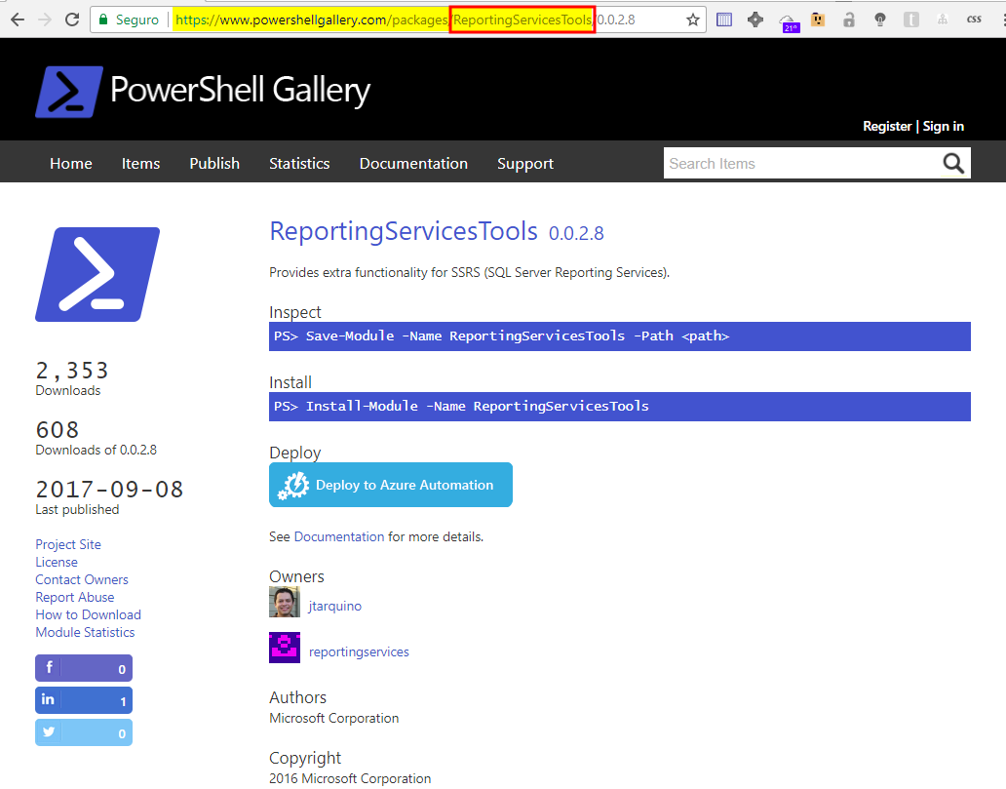
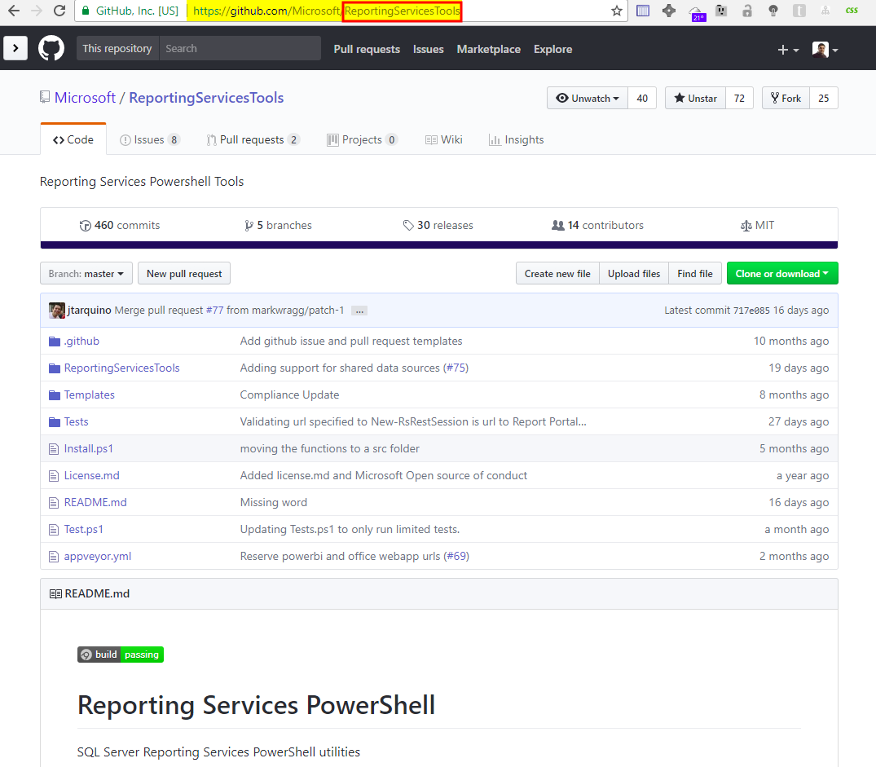
What is ReportingServicesTools and where I can find it?
Open Source PowerShell Module
Allow us to perform various operations with SQL Server Reporting Services
Available on
Contributors
18
Downloads
5160
GitHub
PowerShell Gallery

Slide 7
How does it work?
Three different APIs
SSRS 2012 - 2017
SSRS 2017 / PIBRS October 2017
SOAP
WMI
REST
Reporting Services
&
Web Portal
Reporting Services
Configuration Manager
Reporting Services
& Web Portal
Examples:
Reports
Subscriptions
Examples:
Backup Encryption Key
Set Email Settings
Examples:
Upload / Download Reports

Slide 8
System requirements
Minimum
Client
PowerShell v3+
Server
SQL Server Reporting Services 2012 +
Note: If you want to contribute with features/bug fixes the minimum version should be v4.0 because of Pester testing framework

Slide 9
Installation
PowerShell Gallery
Install-Module –Name ReportingServicesTools
Install-Module –Name ReportingServicesTools –Scope CurrentUser
GitHub
Invoke-Expression (Invoke-WebRequest https://aka.ms/rstools)

Slide 10
What is included?
41 SSRS Commands + 12 PBIRS Commands
Catalog items:
Folders
Data sources
Reports
Subscriptions *
Security:
Grant/Revoke Permissions *
Configuration Manager options *:
Encryption Keys
Email settings
URLs settings
Utilities:
Proxy * / Rest Session
New Catalog Item Role
* Not available on PBIRS (REST API) commands

Slide 11
Known limitations
Missing:
SSL support
More supported extensions (jpg, png, etc)
Work with Shared datasources
Minor bugs:
Write-RsFolderContent fails if a folder (or subfolder with -Recursive) already exists
Submit issues or request features using the “Issues”->”New Issue” or directly from https://github.com/Microsoft/ReportingServicesTools/issues/new

Slide 12
DEMOS!
We will be using v0.0.4.4

